Slide 1
LUMP SUM FUNDING IN HORIZON EUROPE
EDCTP Association as Coordinator of Global Health EDCTP3 projects
Mary Jane Coloma-Egelink | GFO
EDCTP Association

Slide 2

LUMP SUM FUNDING BASIC PRINCIPLES (1)
Lump sum project funding removes all obligations on actual cost reporting and financial ex post audits. No reporting of actual cost.
One objective of lump sum funding is to reduce administrative burden and financial errors associated with reporting actual costs
No financial checks, reviews and audits. Ex-post checks, reviews and audits are limited only to proper implementation (technical) of the action and compliance with non-financial obligations of the grant agreement.
Ex-post controls are focused on technical implementation of the project and not on financial management

Slide 3
LUMP SUM FUNDING BASIC PRINCIPLES (2)
Beneficiaries are not required to submit periodic financial reports and are therefore not required to maintain financial records and supporting documents in lump sum funding. Beneficiaries don’t need in lump sum funding:
  Timesheets
  Payslips or contracts
  Depreciation policy
  Invoices
  WHY? – payments is based on budget per work packages
Beneficiaries must, however, comply with national accounting and reporting requirements. The above items may still be needed for internal accounting requirements to comply with statutory audits.

Slide 4
LUMP SUM FUNDING BASIC PRINCIPLES (3)
The overall lump sum is fixed in the grant agreement, including the breakdown by beneficiary and per work package (Annex 2).
The detailed budget (cost estimations) submitted with the proposal do not become part of the grant agreement.

Slide 5
Horizon Europe: Lump Sum vs Actual Costing

Slide 6
BUDGETING
The estimated budget for the action (lump sum breakdown) is set out in Annex 2.
It contains the estimated eligible contributions broken down by participant and work package.
Amendments for transfers between work packages are possible only if the work packages concerned are not already completed (and declared in a financial statement), and the transfers are justified by the technical implementation of the action.

Slide 7
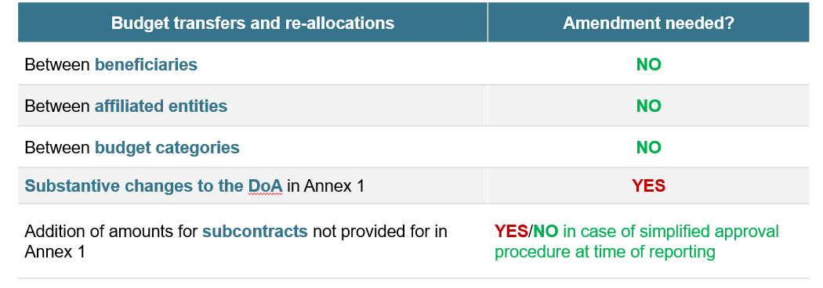
Budget flexibility. Article 5.5 of the MGA

Slide 8
Grant Agreement
Data Sheet
1. General data
  • Project summary (text from DoA Annex 1 Part A (same text as proposal extract). These include key words from the proposal, project number, project name, project acronym, call ID, topic ID, type of action, project start and end dates, project duration and name of granting authority (GH EDCTP 3)
2. Participants
  • This includes role, short name, legal name, country, PIC, total eligible costs and maximum grant amount
3. Grant
  • Maximum grant amount, total estimated eligible costs and contributions and funding rate.
  • Budget categories/activity types, grant form, grant mode and cost eligibility options
4. Reporting, payments and recoveries
4.1 Continuous reporting (article 21)
4.2 Periodic reporting and payments
  • Reporting periods (reporting period number, month from, month to), types and deadline
  • Payment types, deadline (time to pay) and pre-financing amounts
  • Reporting and payment modalities
4.3 Certificates (Article 24)
4.4 Recoveries (Article 22)
5. Consequences of non-compliance, applicable law & dispute settlement forum 6. Other (Specific rules –Annex 5/ Standard time-limits after period end)

Slide 9
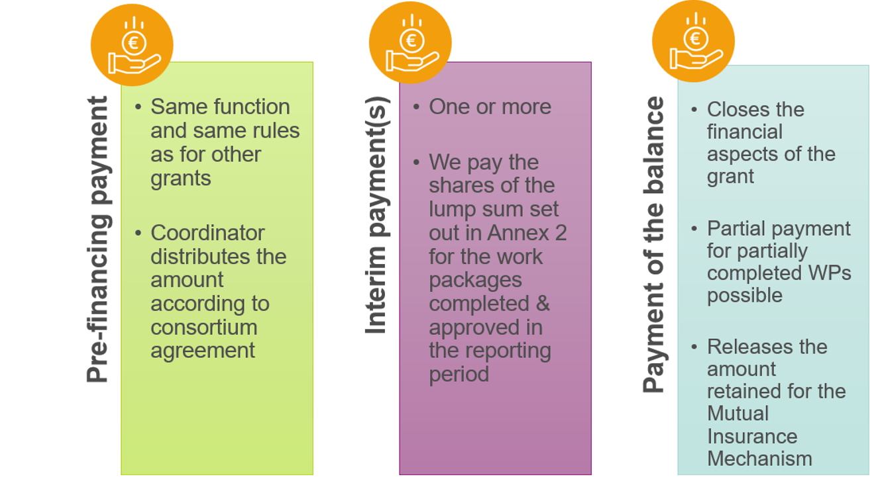
Payment schedule
Types of payments

Slide 10
PAYMENT
The pre-financing for lump sum grants is calculated in the same way as for all Horizon Europe grants. The pre-financing is fixed in the grant agreement.
The contribution to the Mutual Insurance Mechanism will be retained from the prefinancing payments (at the rate and in accordance with the modalities set out in the Data Sheet; Point 4.2) and transferred to the Mechanism.
Interim payments reimburse the eligible lump sum contributions claimed for work packages implemented during the reporting periods.
Payment is subject to the approval of the periodic report and the work packages declared.
The completion of work packages depends on the complete implementation of activities in this work packages according to the project description (Annex 1 of the GA)

Slide 11
Pre-financing amount
Example calculation based on Data sheet
An action with a maximum grant amount of EUR 2,500,000 and a pre-financing amount of 60%. If the MIM rate in the Datasheet is 5%
Maximum grant value – EUR 2,500,000
Pre-financing amount 60% – EUR 1,500,000
Mutual Insurance Mechanism (MIM) 5% - EUR 125,000
Final pre-financing amount - EUR1,375,000
Pre-financing amount reduced by 5% (Mutual Insurance Mechanism (MIM)
Interim payment ceiling (if any): 90% of the maximum grant amount

Slide 12
INTERIM PAYMENT Example P1
Example P1
Annex 2 Grant Agreement (Budget Allocation)
 | WP1 | WP2 | WP3 | WP4 | Total
Beneficiary | EUR | EUR | EUR | EUR
Beneficiary 1 | 500,000.00 | 100,000.00 | 20,000.00 | 300,000.00 | 920,000.00
Beneficiary 2 | 200,000.00 |  | 40,000.00 |  | 240,000.00
Beneficiary 3 |  | 50,000.00 | 90,000.00 |  | 140,000.00
Beneficiary 4 | 40,000.00 | 60,000.00 |  | 25,000.00 | 125,000.00
Total | 740,000.00 | 210,000.00 | 150,000.00 | 325,000.00 | 1,425,000.00
Period 1 (P1): Completed work packages approved by PO of granting authority
 | WP1 | WP2 | WP3 | WP4
Beneficiary | EUR | EUR | EUR | EUR
Beneficiary 1 | Not completed | Completed | Completed | Completed
Beneficiary 2 | Completed |  | Not completed
Beneficiary 3 |  | Completed | Completed
Beneficiary 4 | Not completed | Completed |  | Completed
Interim payment end of period 1
 | WP1 | WP2 | WP3 | WP4 | Total
Beneficiary | EUR | EUR | EUR | EUR
Beneficiary 1 | 500,000.00 | 100,000.00 | 20,000.00 | 300,000.00 | 920,000.00
Beneficiary 2 | 200,000.00 |  | 40,000.00 |  | 240,000.00
Beneficiary 3 |  | 50,000.00 | 90,000.00 |  | 140,000.00
Beneficiary 4 | 40,000.00 | 60,000.00 |  | 25,000.00 | 125,000.00
Total | 740,000.00 | 210,000.00 | 150,000.00 | 325,000.00 | 1,425,000.00
Interim payment P1 | - | 210,000.00 | - | 325,000.00 | 535,000.00
Subject to 90% payment limit

Slide 13
Final Payment (payment of the balance)
The final payment (payment of the balance) reimburses the remaining part of the eligible costs and contributions claimed for the implementation of the action (if any).
The final payment (payment of the balance) after the end of the action.
Payment is subject to the approval of the final periodic report. Its approval does not imply recognition of compliance, authenticity, completeness or correctness of its content.
Final payments can also pay partially completed work packages
This payment is due 90 days from receiving period the final periodic report. The final report is due 60 days after the end of the final reporting period

Slide 14
FINANCIAL REPORTING
Financial report is much simplified and to large extent automated
Financial statement for all beneficiaries is automatically generated (base on the accepted work packages and corresponding lump sum shares
Lump sum contributions for ongoing/not yet completed work packages will have to be included in the periodic report for the next reporting periods when those work packages have been completed.
The explanation on the use of resources (or detailed cost reporting table) and the certificates on the financial statements (CFS) are not required (not applicable) under lump sum costing

Slide 15
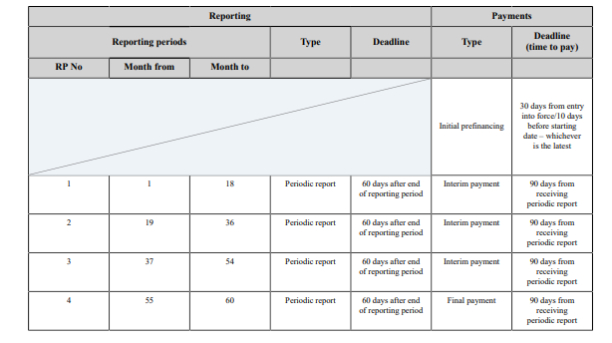
Reporting and payment schedule
Art 21 & 22

Slide 16
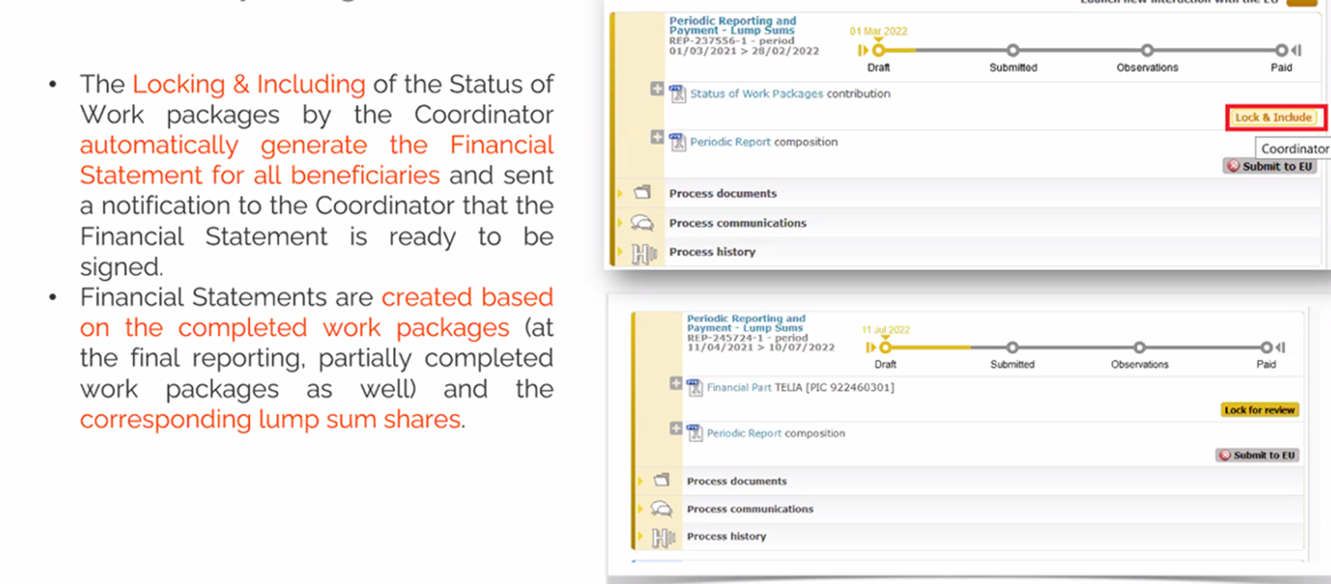
Financial statements
Periodic reporting

Slide 17
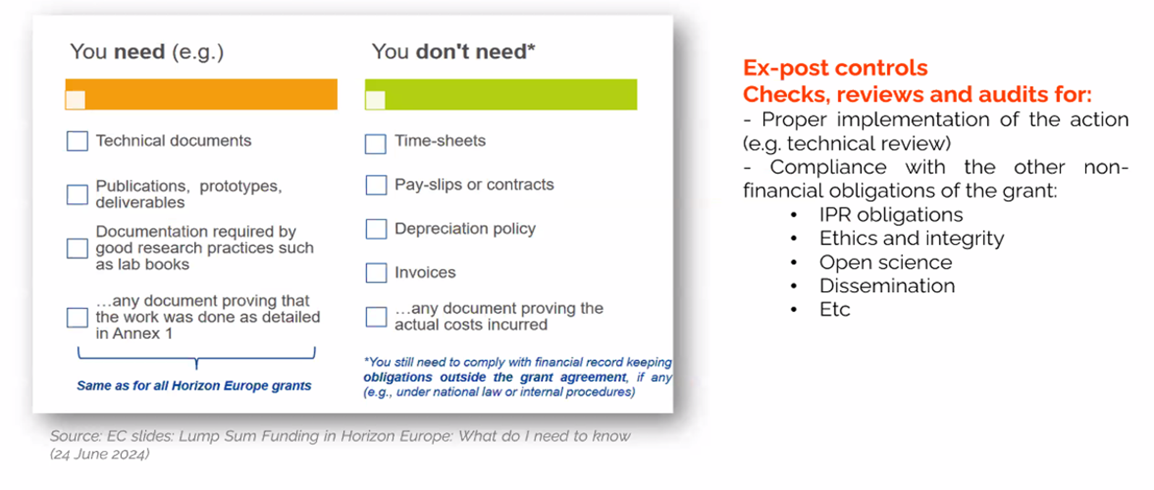
Keeping records
You need vs. You don’t need, however…

Slide 18
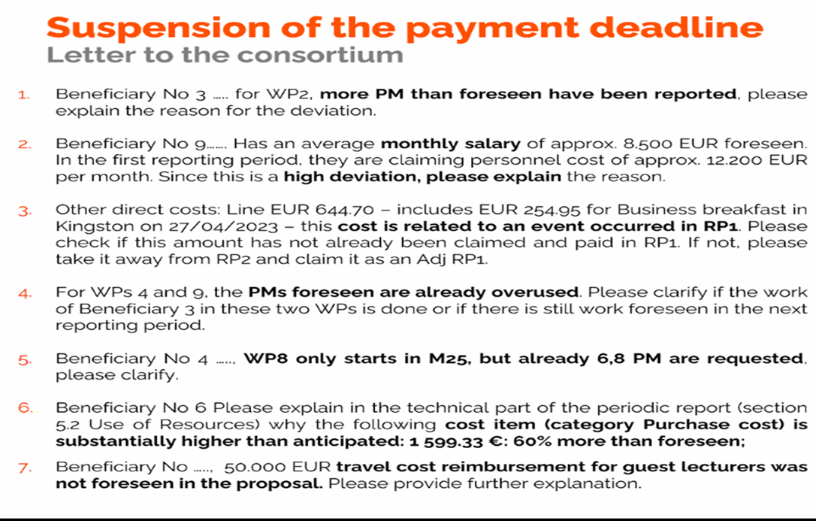
Suspension of the payment deadline
Examples of comments that suspend the payment

Slide 19
Is audit certificate needed for lump costing under Horizon Europe?
No — for Horizon Europe lump sum grants, a Certificate on the Financial Statements (CFS/audit certificate) is generally not required. The EC guidance explicitly states: “Certificates on the financial statements are not used in lump sum grants.”
Lump sum projects are not based on reimbursement of actual costs. Instead, payment is linked to completion of work packages and deliverables.
Therefore:
  No detailed financial reporting of actual costs,
  No usual financial audits on declared costs,
  And no mandatory CFS threshold (e.g. €430k) apply in the normal way for lump sum actions
However, you should keep:
  technical documentation proving the work was carried out,
  evidence of deliverables and milestones,
  and records required by national law/internal procedures.
Hint: EU bodies such as the European Commission, OLAF, or the European Court of Auditors may still perform checks or reviews on implementation, but these focus on whether the agreed work was completed — not on validating actual eligible costs via a CFS.

Slide 20
Thank you very much for your attention
Do you have any questions?

Slide 21
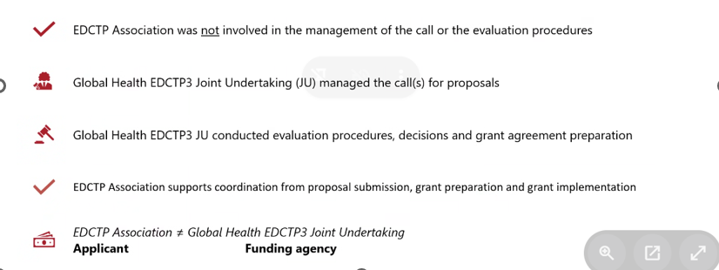
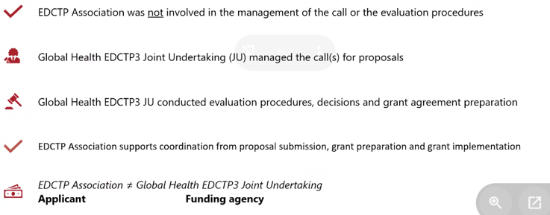
EDCTP Association as Coordinator
Roles and responsibilities

